Slide 1

Rethinking On-Demand Irrigation Systems using IoT Stand-Alone Technologies
Giacomo Ferrarese¹
Giacomo Ferrarese¹, Alessandro Pagano², Davide Troiani¹, Anna Ceni¹, Axel I. Hutomo¹, Nicola Fontana³,
Gustavo Marini³, Stefano Mambretti¹, Stefano Malavasi¹
¹ Politecnico di Milano, Milan, Italy
² IRSA CNR, Bari, Italy
³ Universita degli Studi del Sannio, Benevento, Italy

Slide 2

TABLE OF CONTENT
Introduction
I
II
Case Study
& Methods
III
IV
Results
& Discussion
Conclusions
& Recommendation

Slide 3


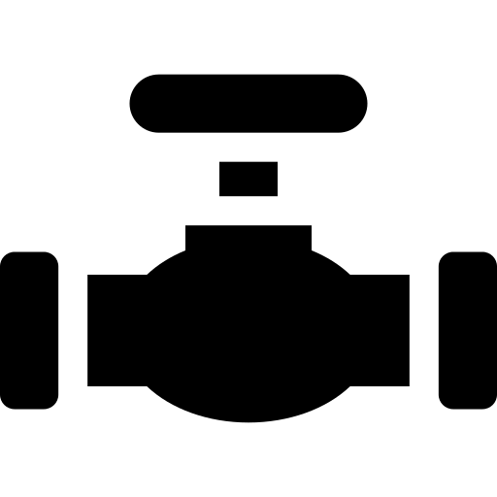

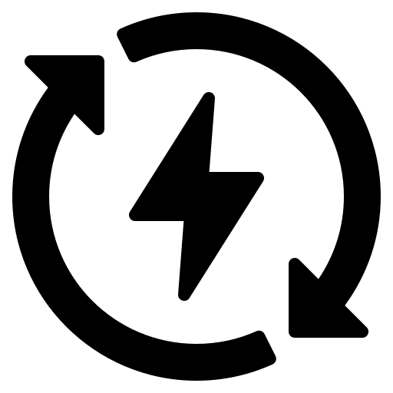

I. INTRODUCTIONS
IoT can be used for
equitable distribution
and efficient water usage
The current phenomenon
of IoT in irrigation areas:
High Interest, Low Adoption ^{[1]}
Green Valve (GVS) and
Off-grid Automatic System
(OAS) have been developed ^{[2,3]}
The application and utility
of IoT in the management
levels remain limited ^{[1]}
These devices can recover energy and add functionalities to the control node
Testing real application impact
on pressure management and
energy recovery

Slide 4
I. INTRODUCTIONS
I think showing a simple description of GVS and OAS in here would be good

Slide 5
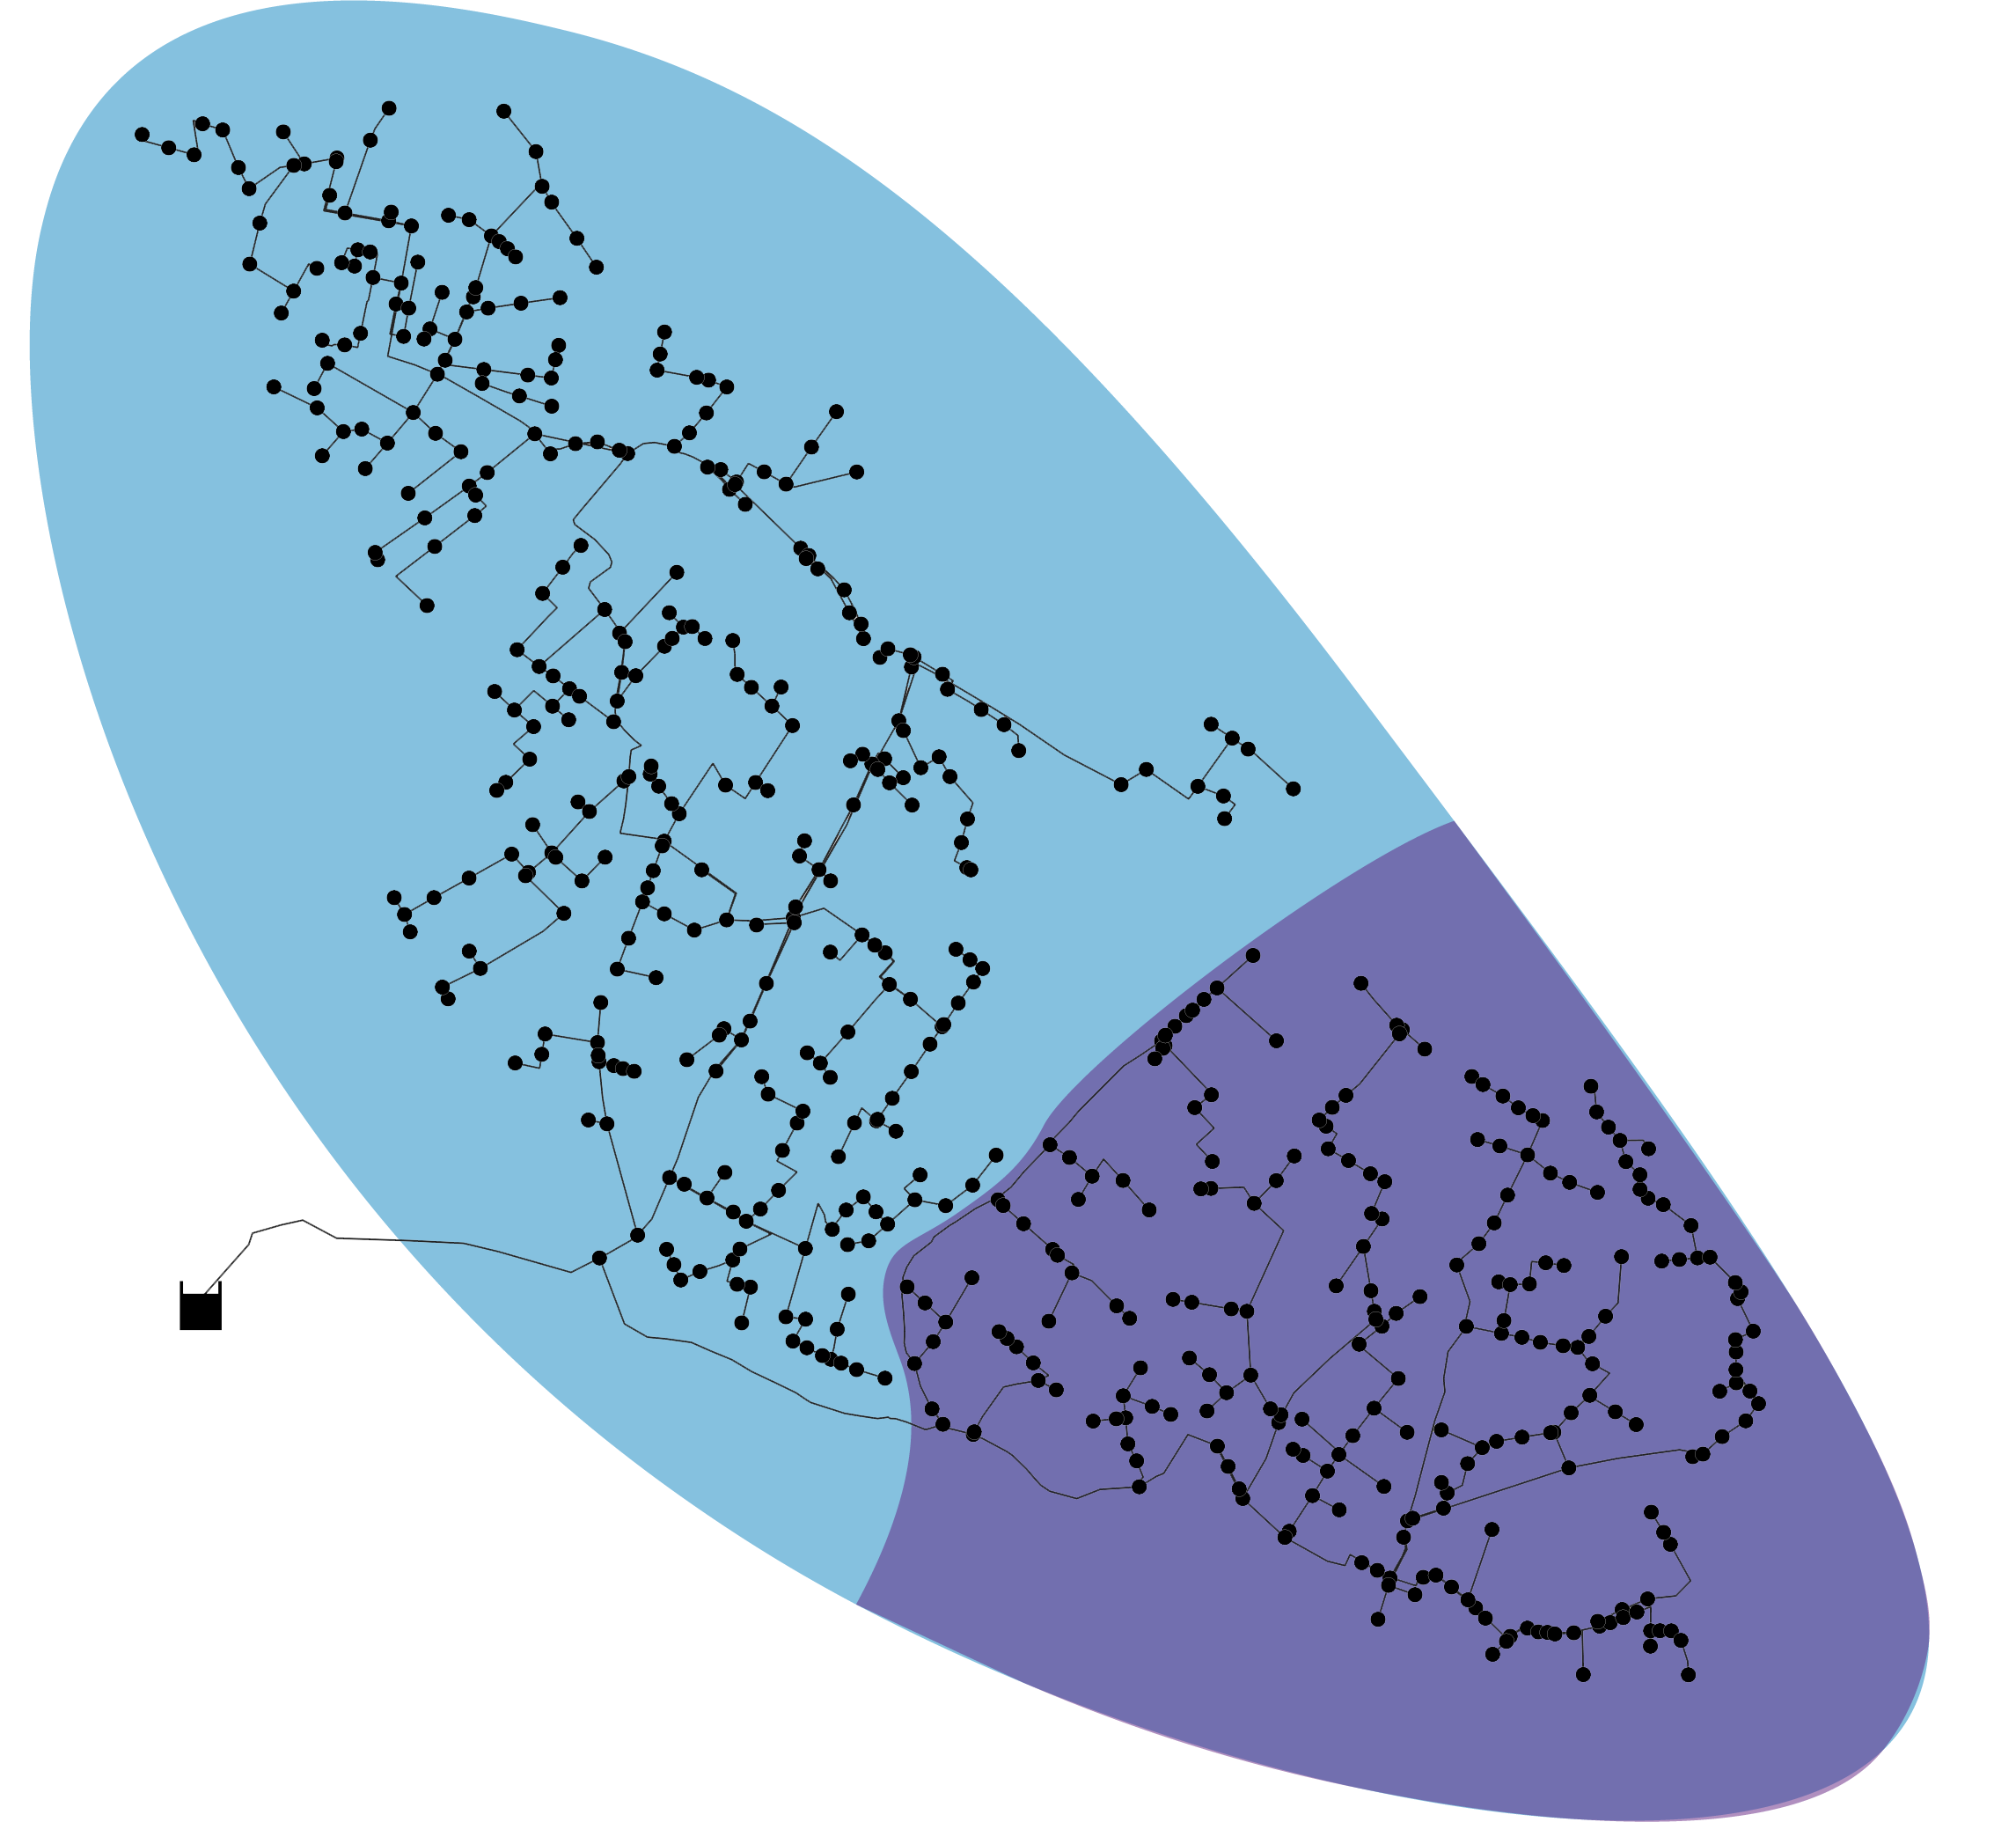
II. CASE STUDY & METHODS
UFITA NETWORKS
An irrigation network in Europe, called UFITA,
was used as a case study. Data for this study was
collected from the Central and Eastern areas.
Legend:
Central Area
East Area
 | East Area | Central Area
No. of nodes | 206 | 368
No. of hydrants | 111 | 92
Pipe length (km) | ? | ?
Type of collected data | Historical hydrant usage
Type of plantation | Vegetables & tobacco
Data collection | Card reader at hydrant
Problems | Deficit & surplus pressure
I think mentioning the central and east areas is enough,
since we didn’t do anything with the western part.

Slide 6
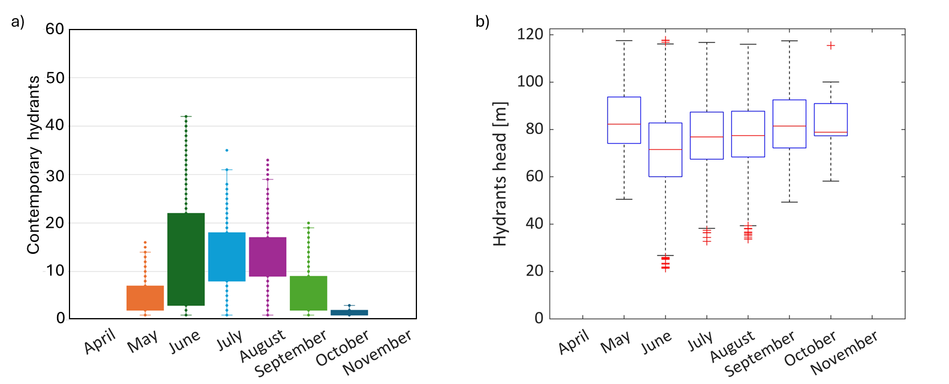
II. CASE STUDY & METHODS
Hydrant Performance Overview by Month
Highest Cont.
Hydrants 45
June presents the greatest challenge for the water distribution system.
JUNE
Hydrant usage : Up to 45 hydrants active (highest of the season)
Pressure : Drops to a minimum of 20 meters
However, most of the hydrants have a surplus of pressure.
Average
Pressure 80m
Therefore, this study investigates minimising pressure according to the real demand of the network by installing two GVS in the east and west zones.
Additionally, the potential for energy recovery due to the installation of OAS is also being investigated.
Minimum Pressure 20m

Slide 7
II. CASE STUDY & METHODS
Start
Perform Hydraulic Simulation
Perform GVS Analysis
Perform OAS Analysis
End
Input:
Input:
Input:
Define the boundary and initial condition
Define the time step (0.5 h)
Set the demand based on historical hydrant usage
Pressure data frame at hydrant nodes
Calculate available pressure for GVS
Calculate the energy consumption of the valve due to the status, communication, and movement of the valve
Output:
Output:
Output:
Pressure data frame at hydrant nodes
Pressure data frame at hydrant nodes after GVS installation
Energy data frame that can be recovered
I think showing a simple diagram like this would help in explaining the methods

Slide 8
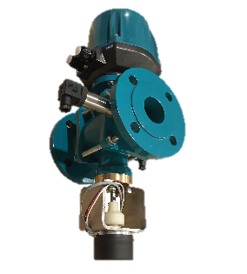
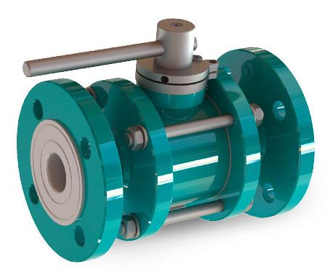
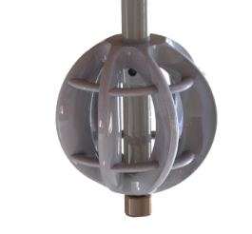
III. RESULTS & DISCUSSION
UFITA NETWORKS
Device Placement
Legend:
The GVS and OAS devices are being
placed at the inlet of the central and east area
Central Area
East Area
+
=
Ball Valve
to control
the flow
Turbine
to harvest
the energy
An IoT self-sustainable control system device
Inlet of
Central Area
Inlet of
East Area

Slide 9
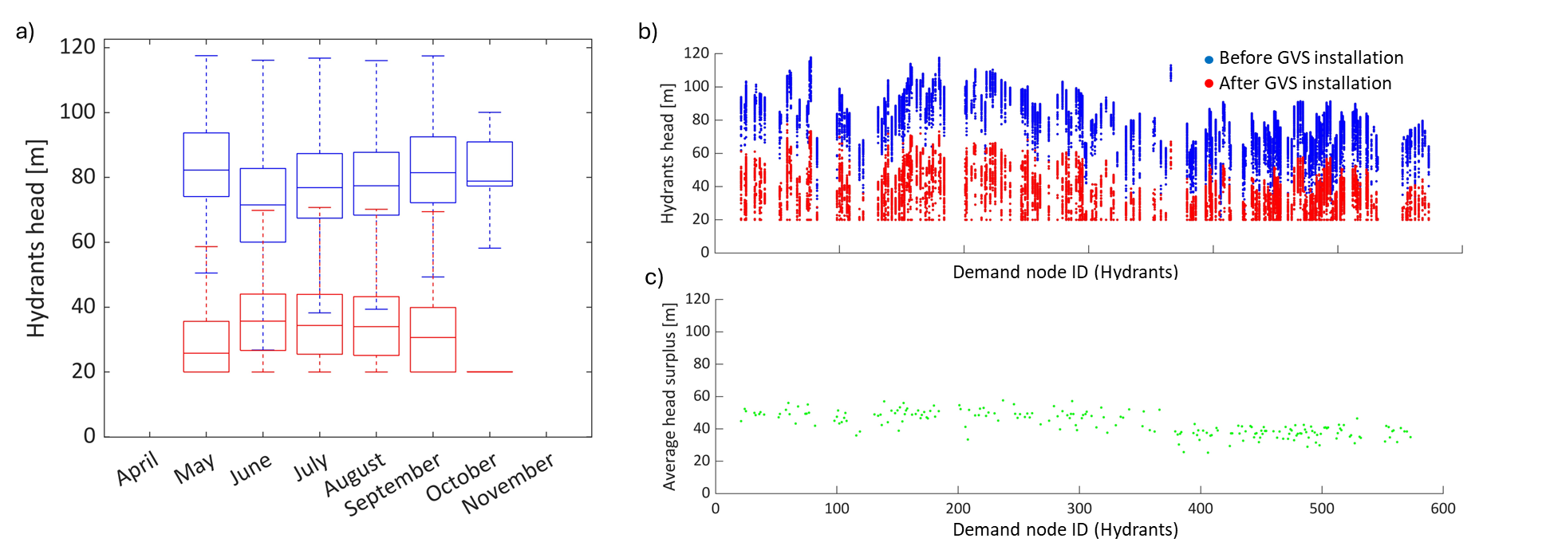
III. RESULTS & DISCUSSION
Pressure at Hydrants
Before and After GVS
GVS Analysis
Installing GVS can reduce pressure at hydrant nodes by around 61% while maintaining the minimum required pressure of 20 meters.
Maybe we can show a colour coded pressure map of our irrigation networks. Before and after GVS. It would help the readers to understand where is the highest pressure in the network and deliver the effectiveness of GVS.
Minimum Pressure 20m
High Pressure
Before GVS
After GVS
Low Pressure

Slide 10
III. RESULTS & DISCUSSION
I think replacing this chart with a color-coded pressure map is better.
Because the viewer also don’t know where the location of demand node ID

Slide 11
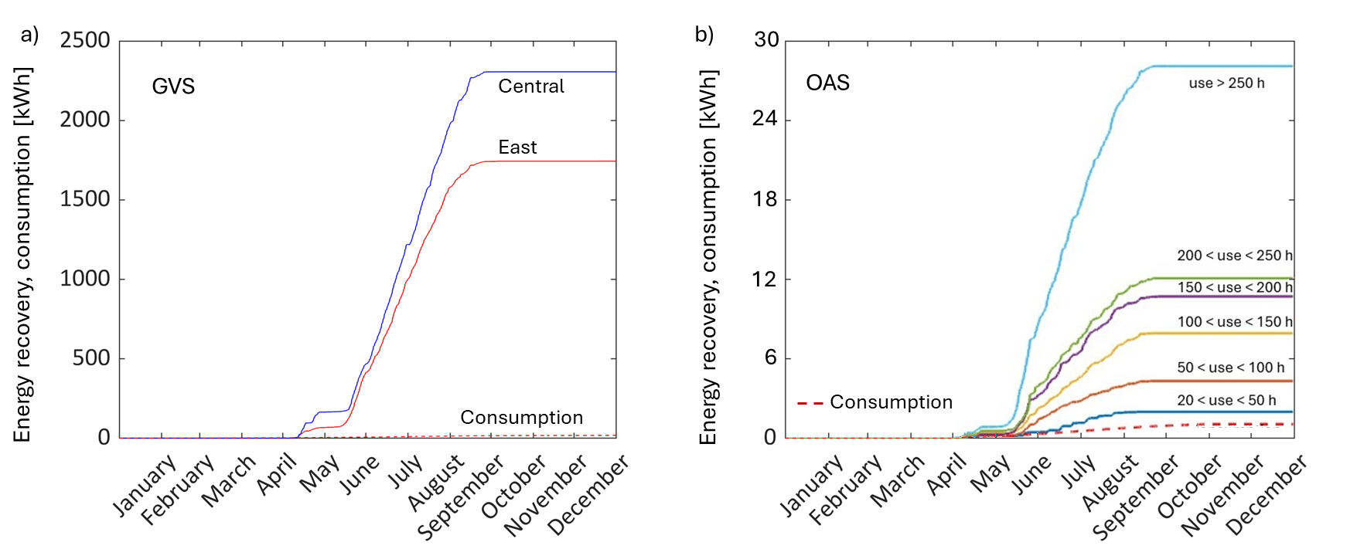
III. RESULTS & DISCUSSION
OAS Analysis
Show a number of required energy to run the device?
And perhaps number of energy that can be recovered?
Off
Season
Period
The most critical period for device sustainability is the off-season period.
No energy is recovered, but a low-continuous consumption is needed for signal reception.

Slide 12
IV. CONCLUSIONS & RECOMMENDATION
Main Takeaway
Further Recommendation
The average pressure reduction in the network by 61% while maintaining the minimum pressure required by the hydrants.
The energy sustainability of the system is proven by verifying the energy balance of several devices throughout the season.
Should we mention that the devices are able to run independently due to the energy recovered by the OAS device?
Conduct an economic assessment for evaluating field installations, and identifying optimal locations for OAS based on their criticality and cost-effectiveness.

Slide 13
Thank you
Giacomo Ferrarese¹
Giacomo Ferrarese¹, Alessandro Pagano², Davide Troiani¹, Anna Ceni¹, Axel I. Hutomo¹, Nicola Fontana³,
Gustavo Marini³, Stefano Mambretti¹, Stefano Malavasi¹
¹ Politecnico di Milano, Milan, Italy
² IRSA CNR, Bari, Italy
³ Universita degli Studi del Sannio, Benevento, Italy

Slide 14
REFERENCES
[1] Xu, J.; Gu, B.; Tian, G. Review of agricultural IoT technology. Artificial Intelligence in Agriculture. 2022, 6, 10–22.
[2] Malavasi, S.; Rossi, M.M.A.; Ferrarese, G. GreenValve: hydrodynamics and applications of the control valve for energy harvesting. Urban Water Journal. 2016, 15, 200–9.
[3] Ferrarese, G.; Pagano, A.; Fratino, U.; Malavasi, S. Improving Operation of Pressurized Irrigation Systems by an Off-grid Control Devices Network. Water Resources Management. 2021, 35, 2813-14, https://doi.org/10.1007/s11269-021-02869-5

Slide 15
SUPPLEMENTARY DOCUMENTS
Additional diagrams or figures to help during the QnA session

